Slide 1
R-CNN

Slide 2
Motivation
Object Detection:
Input: An image
Output: Bounding boxes and classes of the objects in boxes
Sliding window exhaustively classifies each box.
R-CNN: Region-based Convolutional Neural Network

Slide 3
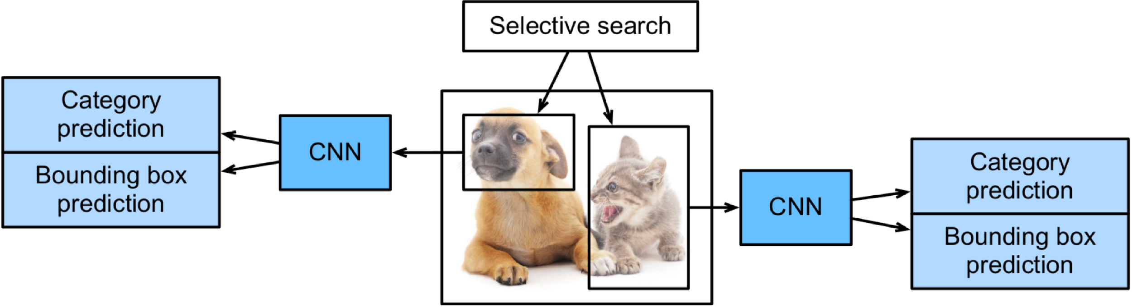
R-CNN
R-CNN workflow :
Selective search + Feature extraction + Prediction
*Girshick et al., 2014

Slide 4
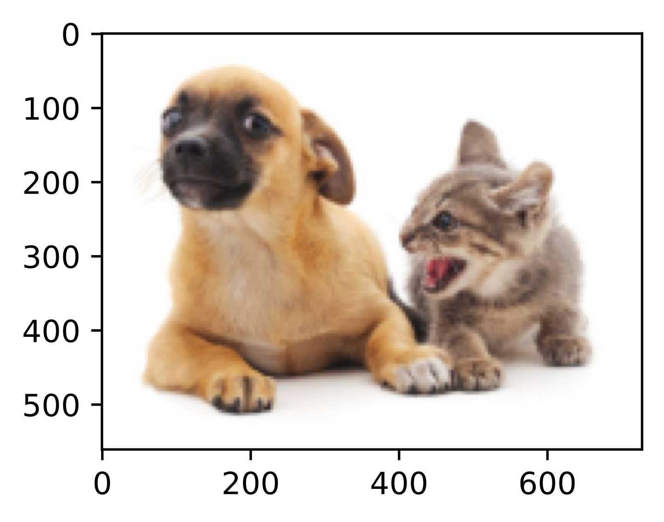
Selective Search*
Generating object bounding boxes by merging similar regions
Not objects
Might be objects
* J. R. Uijlings, et al., Selective search for object recognition. IJCV, 2013

Slide 5
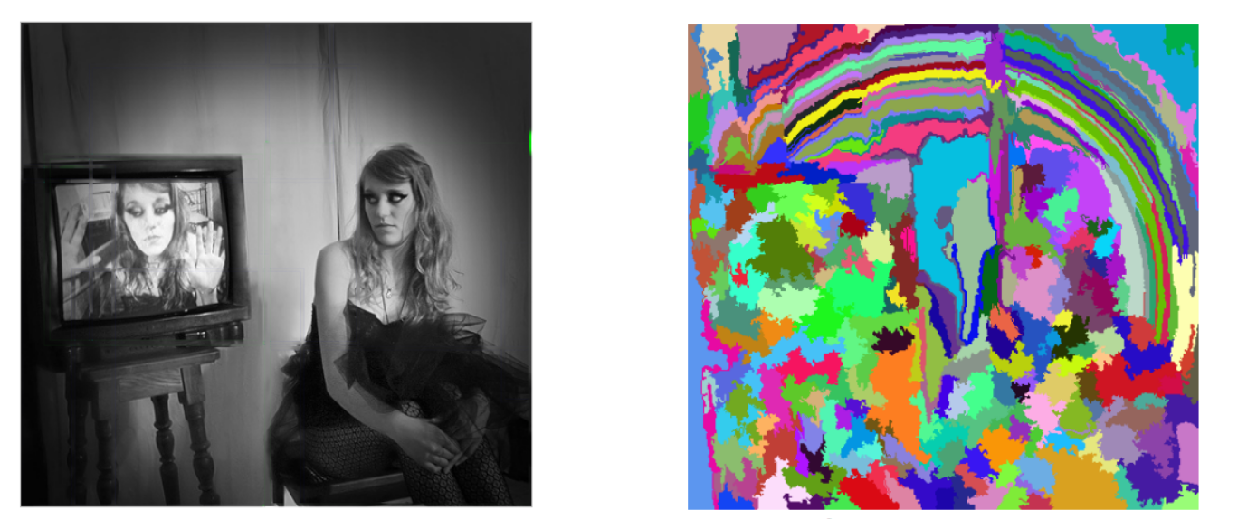
Selective Search
Step 1. Generating initial sub-segmentation
Image
Segmentation

Slide 6

Selective Search
Step 2. Combining regions
Image
Initial Segmentation
Some regions merged
More regions merged

Slide 7
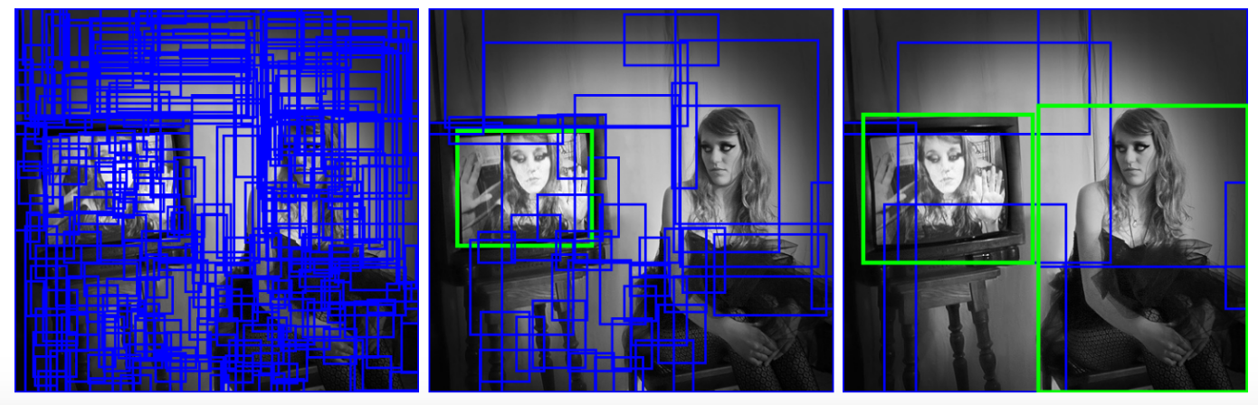
Selective Search
Step 3. Outputting candidate object locations
Image

Slide 8
R-CNN
R-CNN workflow :
Selective search + Feature extraction + Prediction

Slide 9
R-CNN
Feature Extraction
Each box being converted to a square
Going through a pre-trained CNN

Slide 10
R-CNN
Prediction using a pre-trained neural net:
Train a simple classification model for each class.
Train a linear regression model to corrected the bounding boxes.

Slide 11
R-CNN Issues
Training R-CNN is slow and expensive because
Selective search extracting ~2,000 regions per image
Feature Extraction running through this ~2,000 regions with CNNs
Overall, R-CNN is slow in both training and prediction.
Need more improvements!

Slide 12
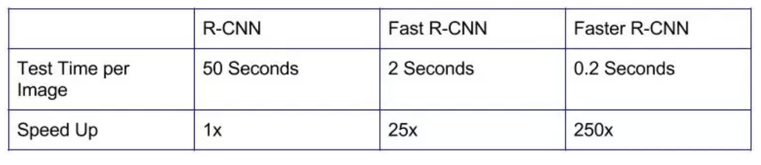
R-CNN Family
Better versions of R-CNN are developed:
Fast R-CNN
More Details on D2L

Slide 13
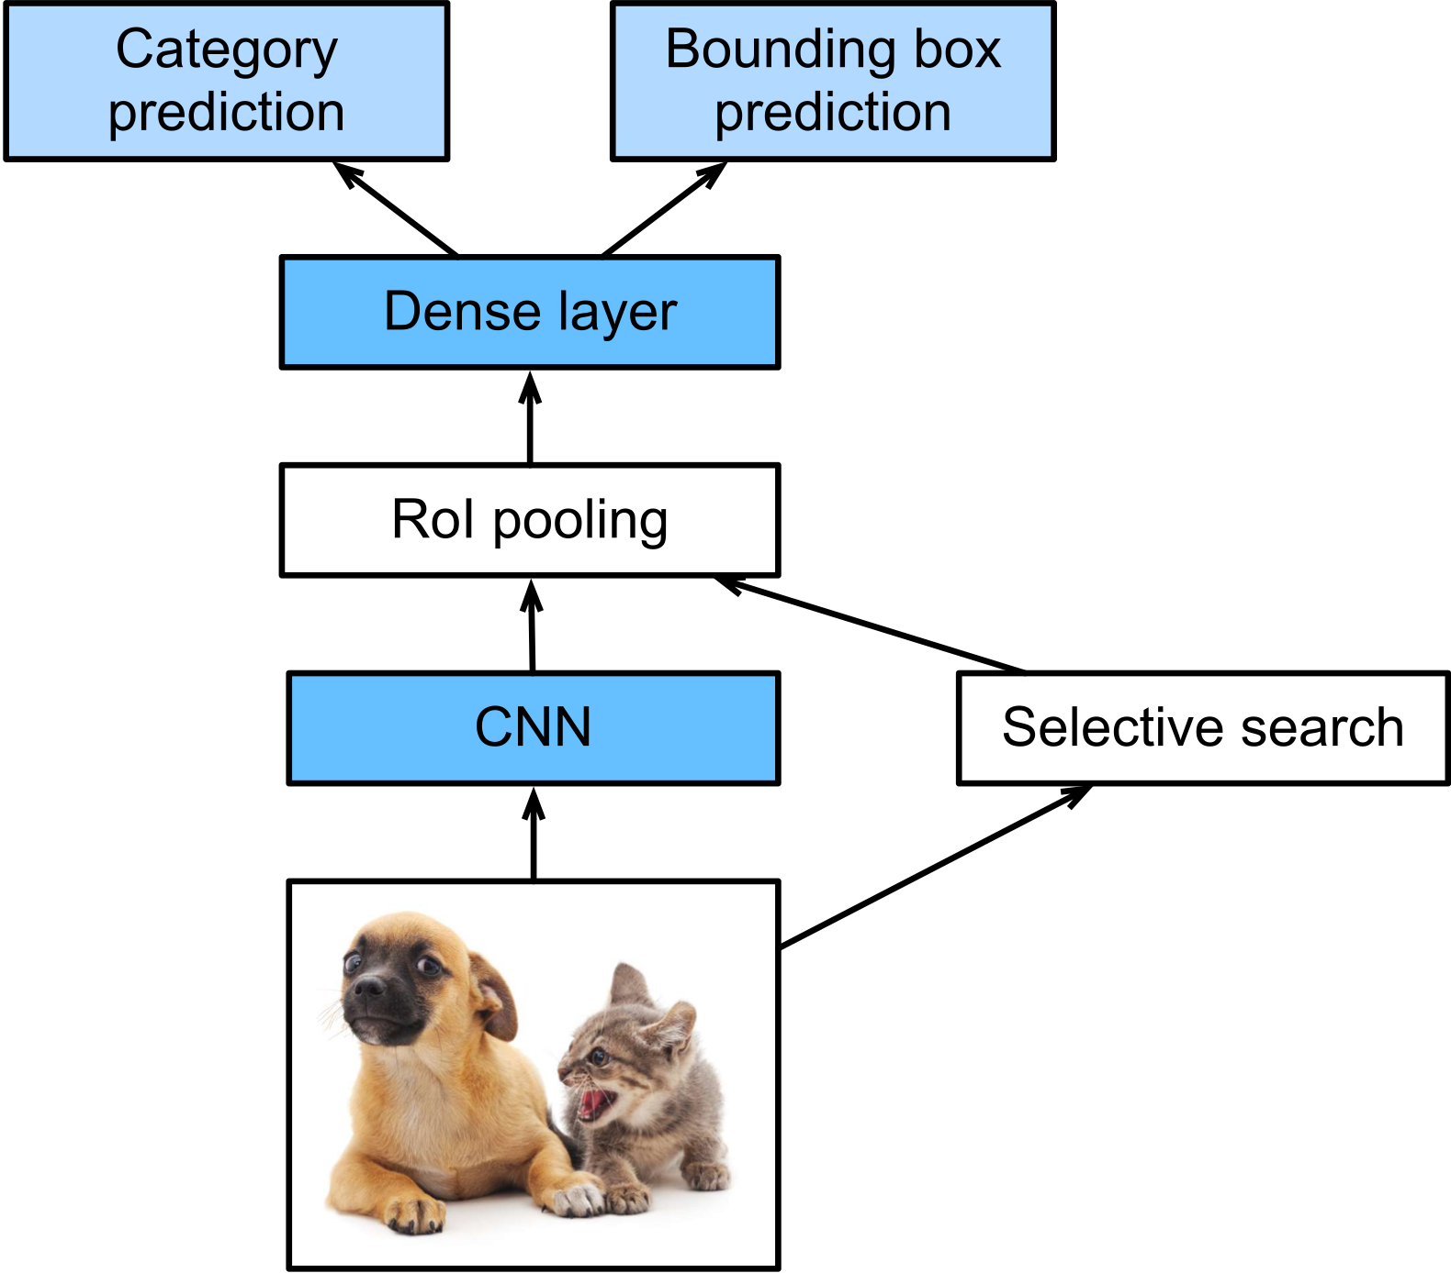
Fast R-CNN
Fast R-CNN* improves by
passing the entire image to the pre-trained CNN
RoI Pooling reshapes the region proposals using a special type of pooling
single-stage training with multi-task loss
* Girshick, R. (2015). Fast r-cnn

Slide 14
R-CNN Family
Better versions of R-CNN are developed:
Fast R-CNN
Faster R-CNN
More Details on D2L

Slide 15
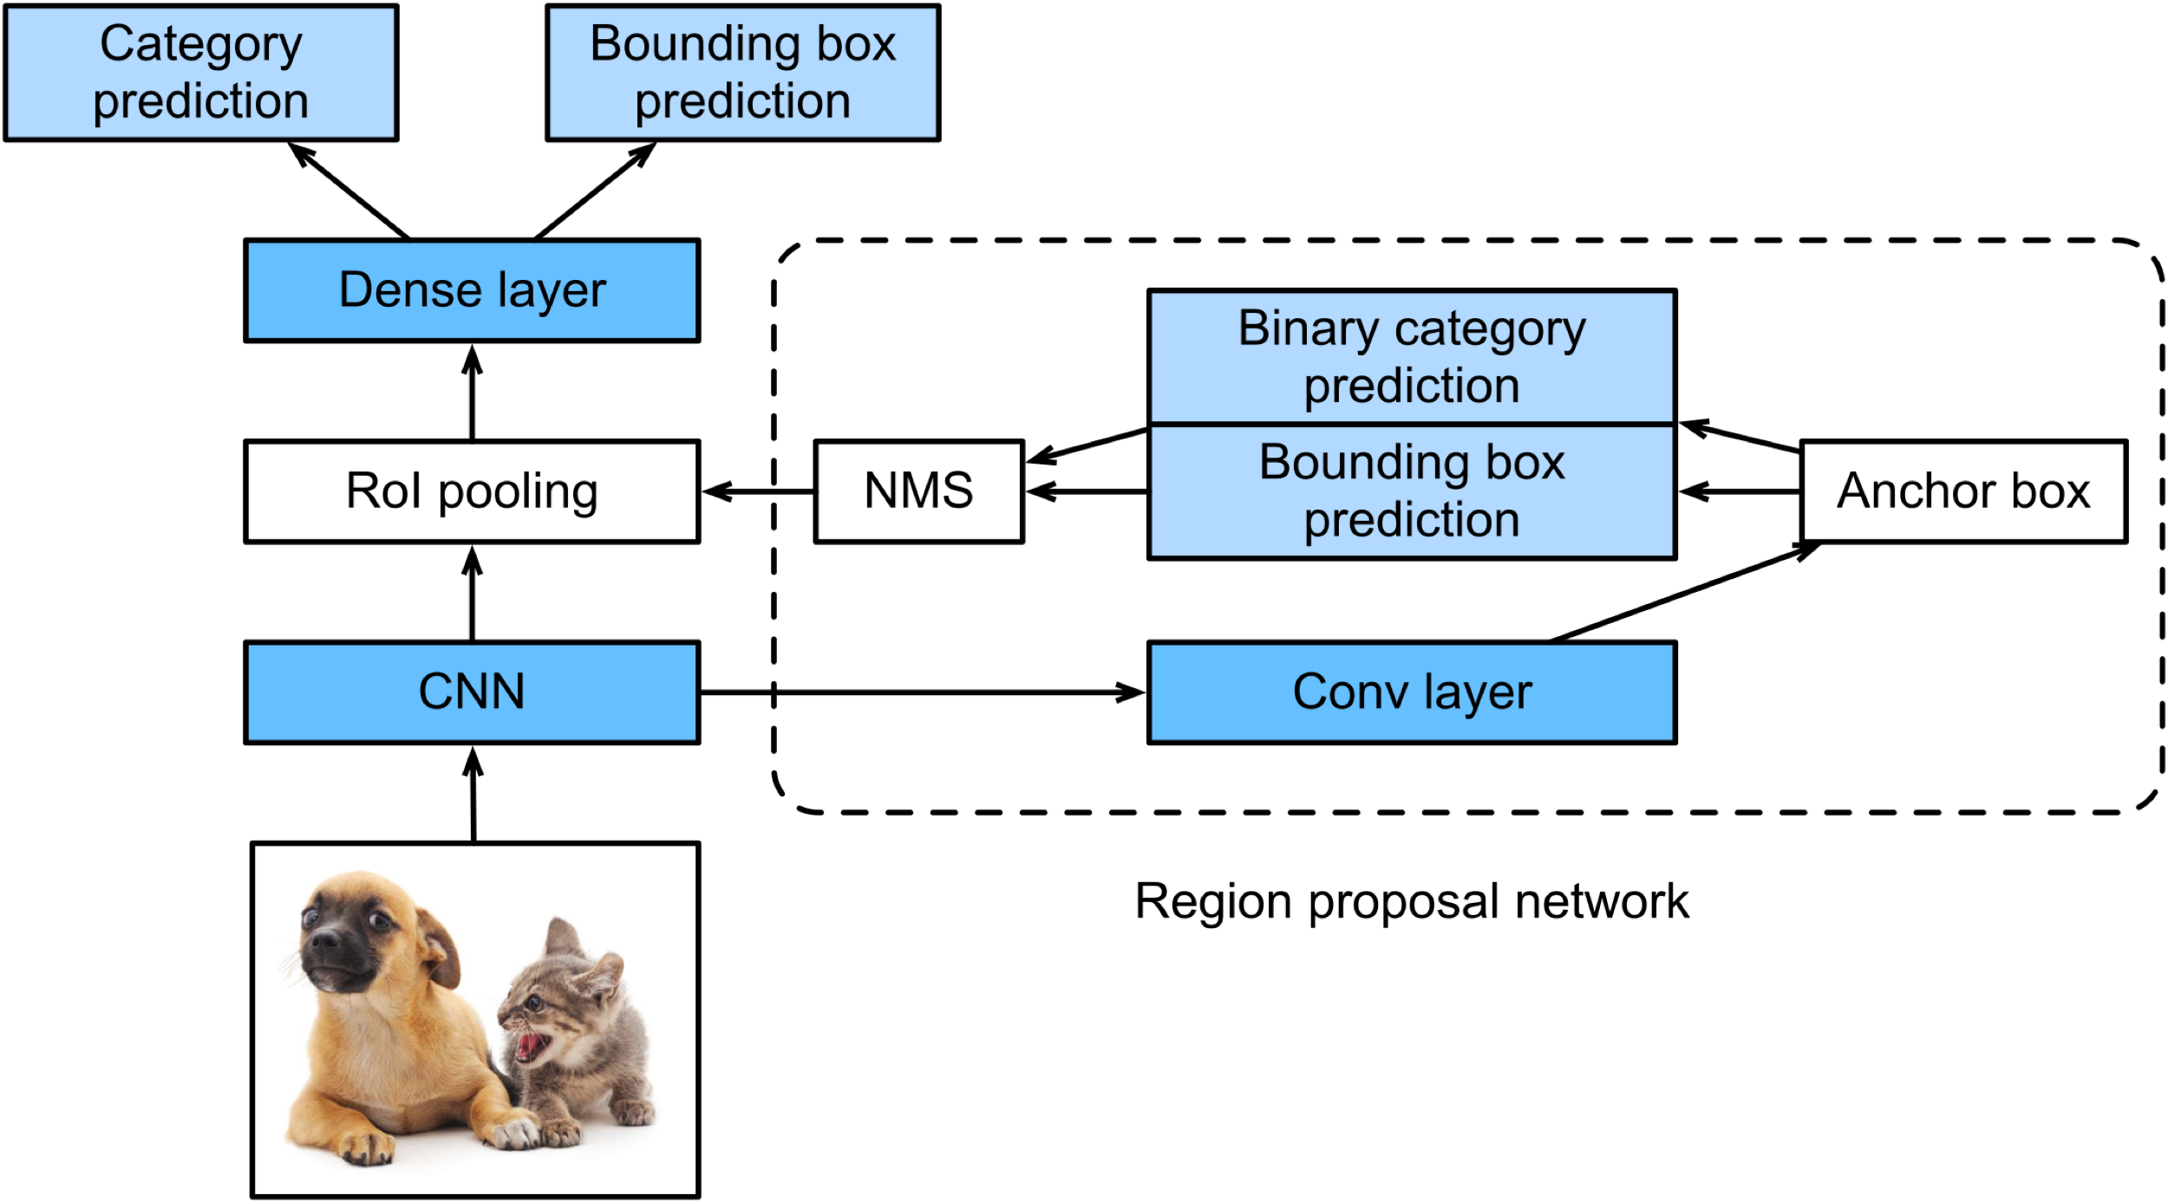
Faster R-CNN
Both R-CNN and Fast R-CNN are using selective search
Faster R-CNN* replaces selective search with a learnable Region Proposal Network (RPN)
* Ren, S., He, K., Girshick, R., & Sun, J. (2015). Faster r-cnn

Slide 16
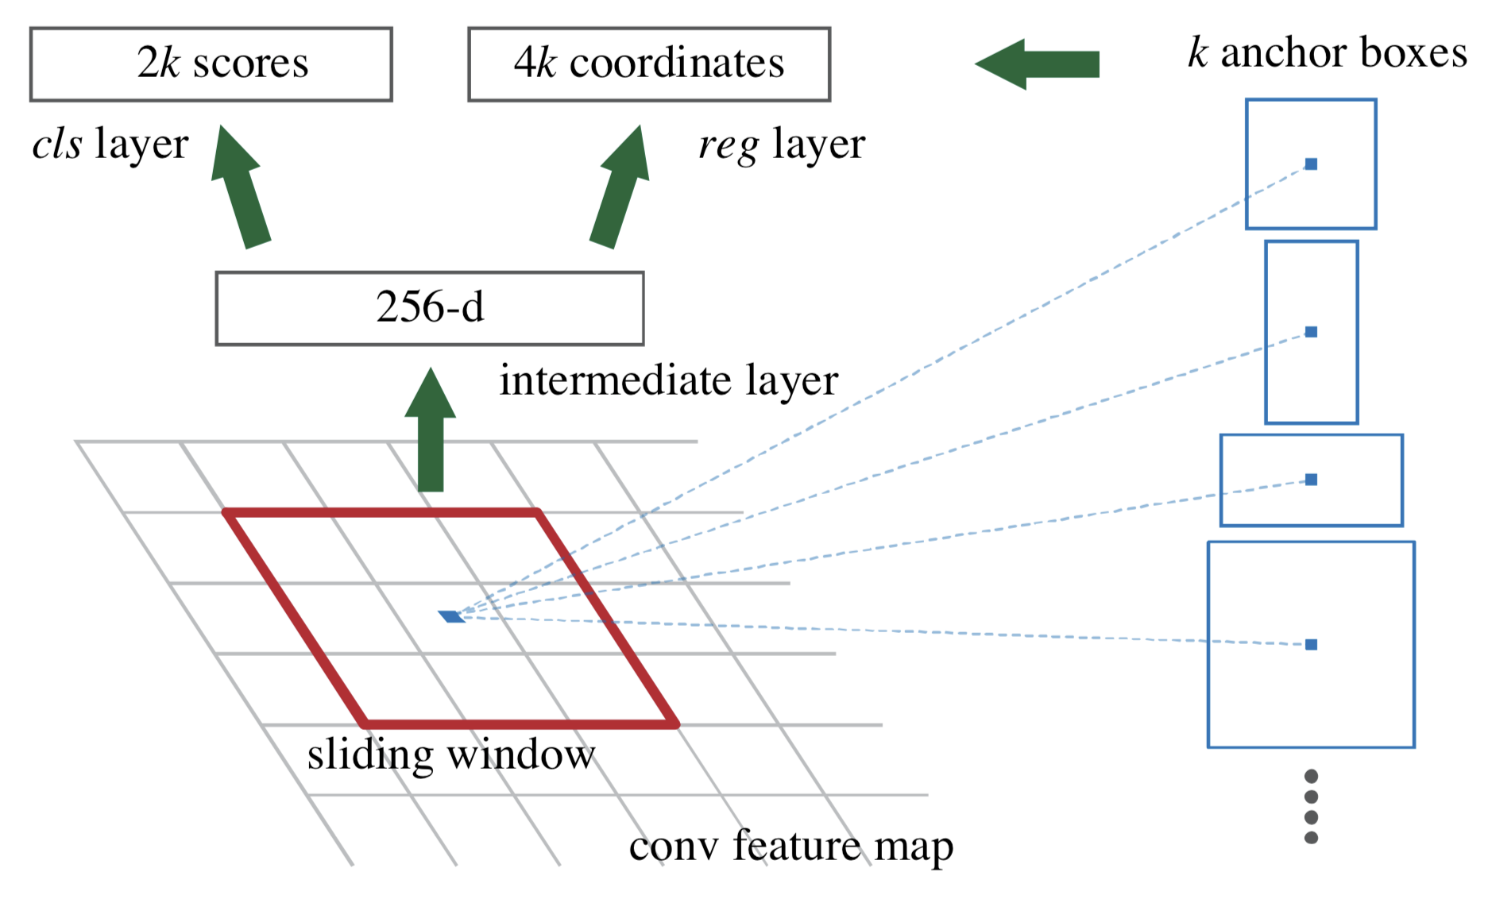
Region Proposal Networks
Small sliding window
K anchor boxes
Non-maimum Suppression (NMS)

Slide 17
Faster R-CNN
Rol Pooling
Multi task prediction
* Ren, S., He, K., Girshick, R., & Sun, J. (2015). Faster r-cnn

